Slide 1

The Empathy Trap:
Overcoming Leadership Manipulation
Natalie N. Lasky, MA
Advisor: Dr. Rebecca Curnalia
Youngstown State University

Slide 2
EMPATHY
Understanding others’ thoughts
and emotions
Can be used to support… or manipulate
Exists in multiple forms
(adaptive, cognitive, dark)
(Vachon & Lynam, 2015)

Slide 3
LITERATURE REVIEW

Slide 4
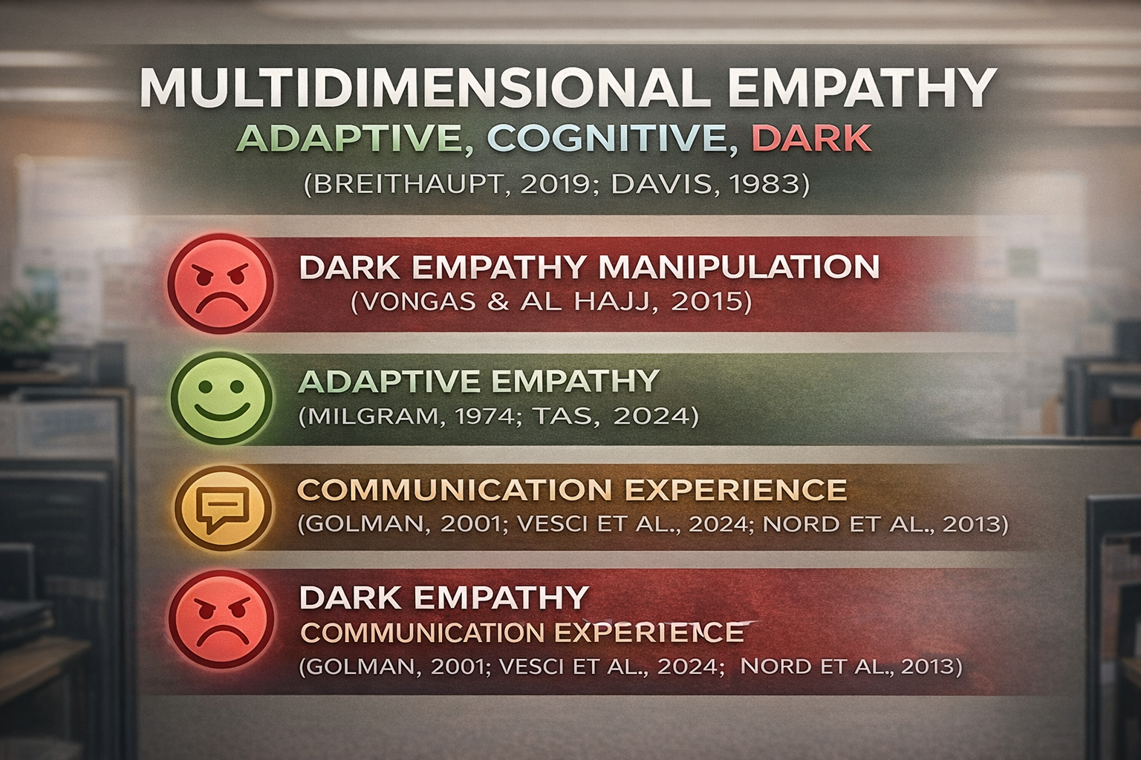

Slide 5
RESEARCH PROBLEM
EMPATHY IS CELEBRATED IN LEADERSHIP
EMPATHY CAN BE MANIPULATIVE (DARK EMPATHY)
SUPERVISOR COMMUNICATION MODIFIES IMPACT
Objective:
  Explore Empathy Styles with
    Job Satisfaction
    Emotional Response
    Productivity

Slide 6
HYPOTHESES

Slide 7


Slide 8
METHODOLOGY

Slide 9
METHODOLOGY
Sample:
N = 169 ADULT EMPLOYEES
(AGES 18 – 85; ENTRY-LEVEL THROUGH POST DOCTORATE)
Diverse Sectors:
OFFICE, SERVICE, HYBRID, MANUAL LABOR
Design:
ONLINE SURVEY (QUALTICS)
Measures:
10-ITEM, 5-POINT LIKERT SCALES
(FOR EACH VARIABLE)

Slide 10
RESULTS

Slide 11
MEAN, STANDARD DEVIATION, AND CRONBACH ALPHA
INDEPENDENT
  ADAPTIVE EMPATHY
    M = 3.63; SD = 1.02; α = .95
  COGNITIVE EMPATHY
    M = 3.25; SD = 1.04; α = .94
  DARK EMPATHY
    M = 2.28; SD = 1.30; α = .97
MODERATOR
  SUPERVISOR COMMUNICATION
    M = 2.13; SD = 1.14; α = .94
DEPENDENT
  EMOTIONAL RESPONSE
    M = 3.76; SD = 0.74; α = .76
  JOB SATISFACTION
    M = 3.47; SD = 1.07; α = .93
  PRODUCTIVITY
    M = 4.40; SD = 0.58; α = .91

Slide 12
REGRESSIONS

Slide 13
JOB SATISFACTION (BASE MODEL)
MODEL: R² = .77, p < .001
ADAPTIVE EMPATHY → β = .25, p = .006
COGNITIVE EMPATHY → β = .29, p < .001
DARK EMPATHY → β = –.42, p < .001

Slide 14
JOB SATISFACTION (WITH COMMUNICATION)
MODEL: R² = .79, p < .001
COGNITIVE EMPATHY → β = .34, p < .001
COMMUNICATION → β = –.37, p < .001
ADAPTIVE EMPATHY → NOT SIGNIFICANT
DARK EMPATHY → NOT SIGNIFICANT

Slide 15
EMOTIONAL RESPONSE (BASE MODEL)
MODEL: R² = .65, p < .001
ADAPTIVE EMPATHY → β = .26, p = .022
COGNITIVE EMPATHY → β = .22, p = .015
DARK EMPATHY → β = –.39, p < .001

Slide 16
EMOTIONAL RESPONSE (WITH COMMUNICATION)
MODEL: R² = .69, p < .001
COGNITIVE EMPATHY → β = .28, p < .002
COMMUNICATION → β = –.47, p < .001
ADAPTIVE EMPATHY → NOT SIGNIFICANT
DARK EMPATHY → NOT SIGNIFICANT

Slide 17
PRODUCTIVITY
MODEL: R² = .12, p < .001
EMOTIONAL RESPONSE → β = .36, p < .008
ADAPTIVE EMPATHY → β = .38, p < .043
DARK EMPATHY → β = .31, p < .026
COGNITIVE EMPATHY → NOT SIGNIFICANT

Slide 18
INTERPRETATIONS
COGNITIVE EMPATHY → STRONGEST POSITIVE PREDICTOR
DARK EMPATHY → HARMFUL
(REDUCED W/ COMMUNICATION)
COMMUNICATION → DOMINANT INFLUENCE
PRODUCTIVITY → WEAKLY PREDICTED

Slide 19

THANK YOU!

